Slide 1
opim 5641: Business Decision Modeling
Jan Stallaert

Slide 2
Course Overview
Two main goals:
Spreadsheet engineering
Modeling using spreadsheets
Spreadsheet engineering:
Naming and addressing ranges
Workbook layout
Conditional formatting and dashboards
Using external data sources

Slide 3
Modeling with spreadsheets
Sensitivity Analysis
Tornado charts, scenarios, break-even analysis
Optimization Models
Linear models with fractional quantities
Linear models with integer quantities
Models with yes-no decisions
Sensitivity of optimal solutions

Slide 4
Course Resources
HuskyCT:
Powerpoints
Spreadsheets needed
Homeworks and Cases
Need Excel with latest service packs
Need the required add-in Analytic Solver Platform for the course
Textbook: Powell and Baker, 3rd or 4th edition

Slide 5
Grading
The grade distribution is as follows:
Homeworks 40%
In-Class Quiz: 30%
Case: 20%
Class Participation: 10%

Slide 6
Naming and addressing
Three different ways to refer to cells or ranges
A1,$A$1: most known column-row-style reference
R1C1: less known
Naming a cell (important for our purposes)

Slide 7
Column-Row Style
Example: A1 refers to the upper left hand cell, “A” being the column, “1” the row
When a formula is copied, the reference changes
“$” anchors the row/and or column
E.g.:
$A$1: when copied, will always refer to the same cell
$A1: when copied, will always refer to column A, but the row will change
A$1: when copied, will always refer to the first row, but the column will change

Slide 8
R1C1 style
Rows and columns are numbered
E.g., R15C6 refers to the cell in row 15, column 6, i.e., this is an “anchored” or absolute reference
Use [] to create relative references:
Ex.: R[1]C[-2] refers to the cell one row below and two columns to the left of the current cell
Ex.: R[-3]C[5] refers to the cell three rows above and five columns to the right of the current cell
Note: R[1]C[0], becomes just R[1]C
Need to check “R1C1 reference style” in the “Formula” tab of Excel options (Office button/File > Excel Options > Formulas > R1C1 reference style
Advantage of R1C1: formulas, when copied, retain the original cell references: easier to find errors

Slide 9
R1C1
Currently, the cursor is at row 12, column 8. Which cells do the following refer to?
RC[-2]
R[-5]C[3]
R[2]C
R[1]C[-1]
RC

Slide 10
Naming Cells or Ranges
Cells or Ranges can be given a name:
Select cell or range
Enter name in the name box (left of function); or
Formulas > Defined Names > Define Name
When used in formulas, named cells are absolute addresses
Can be referenced from other sheets without having to prefix with “Sheet1!” etc.
Can use “nested” names, i.e., generic “products” subdivided into “candy” and “cookies”

Slide 11
Conditional formatting
Changing cell and font colors
Adding bars to data cells to represent numbers
Rule priorities and stopping rule
When one cell has multiple formatting rules

Slide 12
Highlight Cells based on Formula
Conditional Formatting > New Rule > Use a formula …
Rule description:
Enter a logical formula, e.g. (NOTE the “=“ sign):
=e4<e3 for numbers
=OR(k4=k2,k4=“apples”,k4=“oranges”)
Enter the format you want displayed
Press “Apply” or “Enter”

Slide 13
Highlighting Ranges based on formulas
Apply conditional formatting to first cell and use format painter
Select whole range
Formula entered for the rule only pertains to the first cell
The logic is copied to the other cells of the range with the cells’ addresses adjusted: Do NOT use absolute address in the Rule description (NO $s)

Slide 14
Useful Functions and Commands
Excel functions
sumproduct
if
index
hlookup/vlookup
sumif/countif
Commands
Protect Cells and Worksheets
Use Navigation / Links

Slide 15
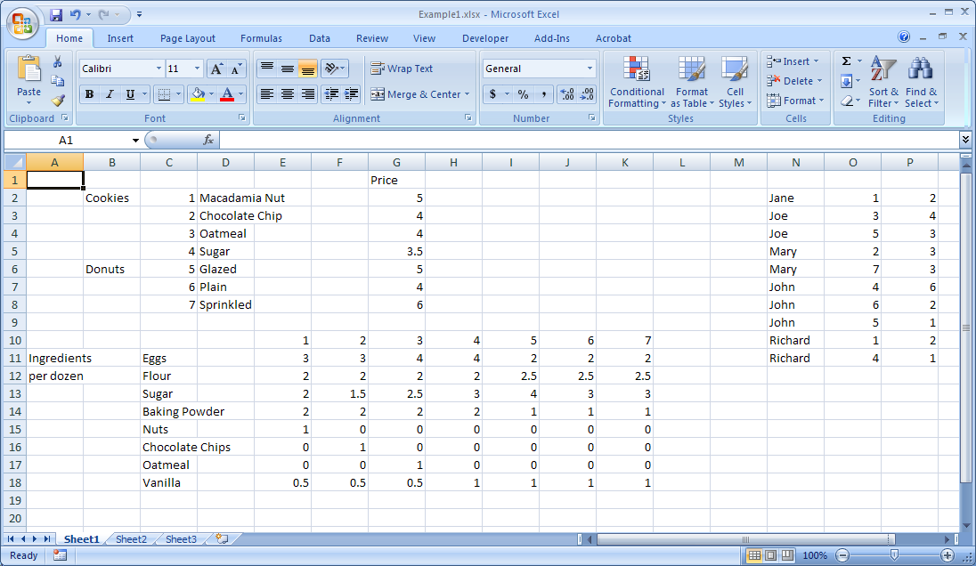
Example
Product Info
Order Info
Recipe Info

Slide 16
Needed
How many should I bake of each?
How much ingredients are required for this bake plan?
How many dozens of each baked good have been ordered?
How many orders are there for each baked good?
What is the sales total for each order?
What is my revenue?
How much ingredients are used for cookies, how much for donuts?
Is my baking plan feasible (i.e., all orders filled)?
Can I make my workbook easy to use?
Can I make it foolproof?

Slide 17
What you will learn
Basic Excel commands and functions
Naming Ranges and their use
Functions: hlookup, index, sumproduct, sumif, countif, if
Conditional formatting based on a Rule (formula)

Slide 18
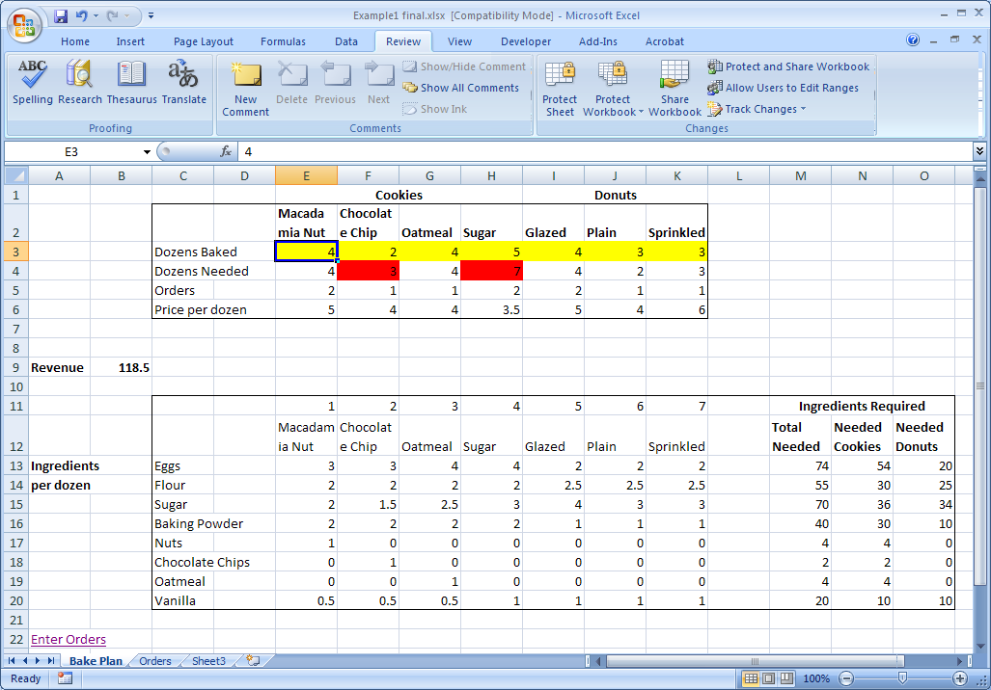
Final Product
Final Worksheet

Slide 19
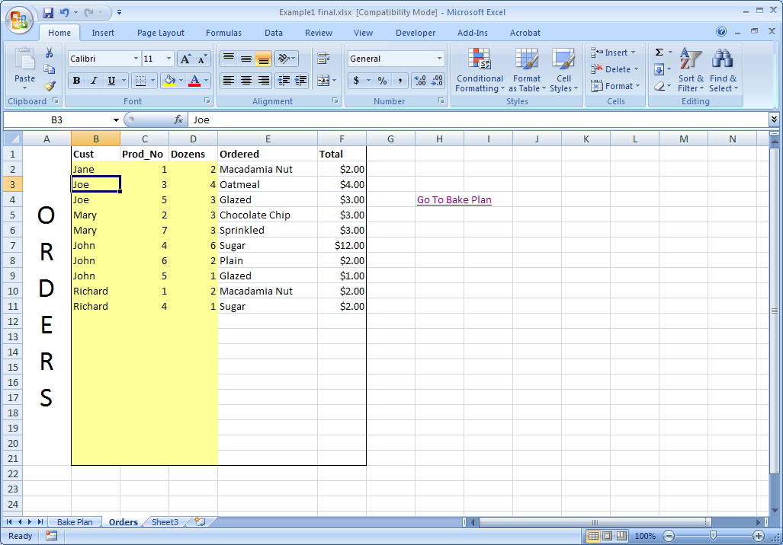
Final Worksheet (cont’d)

Slide 20
Getting real-time data from external sources
Getting data from tables on Web pages or databases
Data can be automatically refreshed
Cookie order example:
http://users.business.uconn.edu/jstallaert/opim5641/orders.htm
Cell contents can be parsed using the Excel functions left, right or mid and (optional, to embellish the output) isblank

Slide 21
When the data returned keeps shifting
Find a constant string that precedes the data of interest (e.g., “Orders submitted”)
Using the “match” function, locate the row (column) where this string appears
Using the “offset” function, use the location of this row to extract the correct data
Hint: you may now think that all the data starts in cell A1, and then offset this reference by the correct rows/columns

Slide 22
Assignments
Excel refresher: chapters 3 and 4 (section 4.7 is optional)
Prepare chapters 5 and 6 (see syllabus)
Homework I

